Slide 1
Analysis Recursion Function

Slide 2
Example 1
void fun(int n)
{
if(n<=0)
return ;
print(“LPU”);
fun(n/2);
fun(n/2);
}

Slide 3
T(n)= T(n/2)+ T(n/2) + θ(1)
T(n)= 2T(n/2) + θ(1)
If n<=0
T(n)= θ(1)
i.e.
n=0;
T(0)= θ(1)

Slide 4
Example 2
void fun(int n)
{
if(n<=0)
return ;
for( int i=0; i<n; i++)
print(“CSE”);
fun(n/2);
fun(n/3);
}

Slide 5
When n>0
T(n)= T(n/2)+ T(n/3) + θ(n)
When n=0;
T(0)= θ(1)

Slide 6
Example 3
void fun(int n)
{
if(n<=1)
return ;
for( int i=0; i<n; i++)
print(“CSE”);
fun(n-1);
}

Slide 7
When n>1
T(n)= T(n-1)+ θ(n)
When n<=1;
T(1)= θ(1)

Slide 8
Recursion tree method for Solving Recurrences
We consider the recursion tree and compute total work done.
We write non-recursive part as root of the tree and write the recursive part as children
We keep expending until we see a pattern

Slide 9
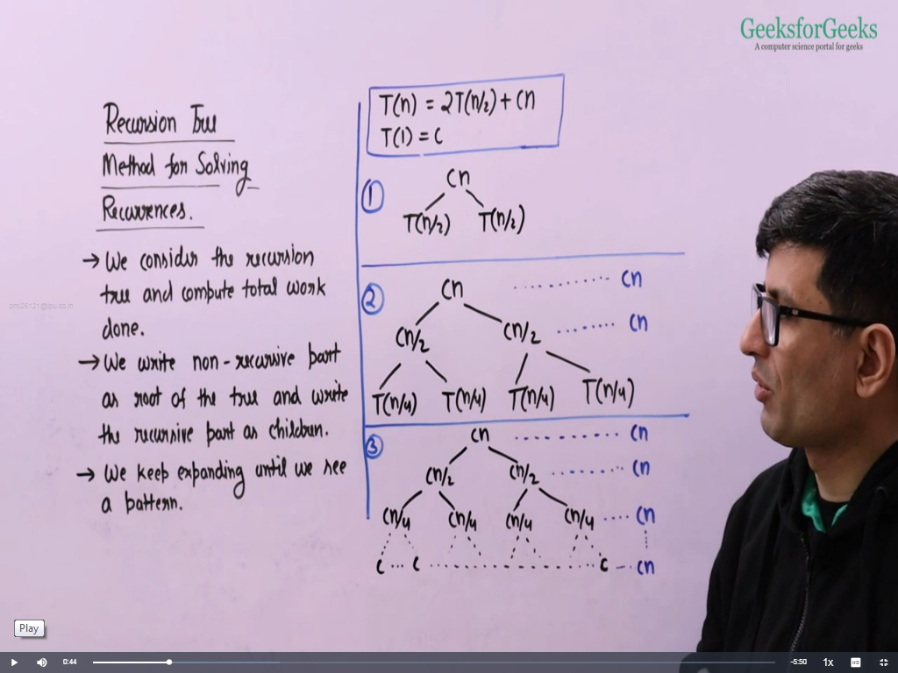

Slide 10
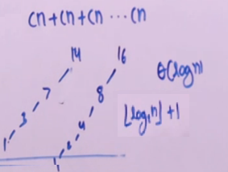
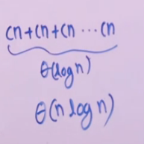

Slide 11
More Example
T(n)=2T(n-1)+c
T(1)=c

Slide 12
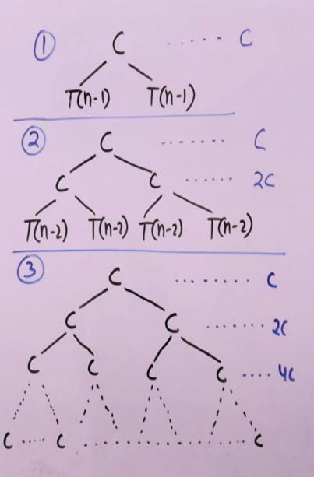
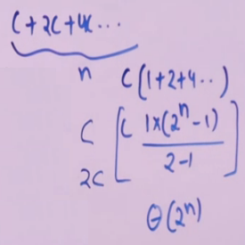

Slide 13
T(n)=T(n/2)+c T(1)=c

Slide 14
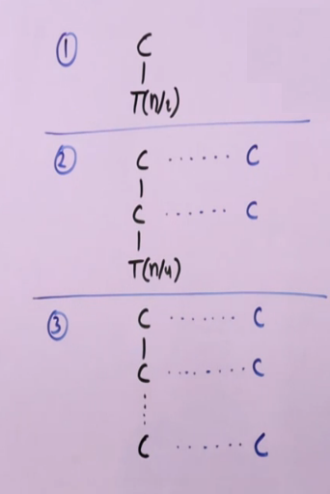
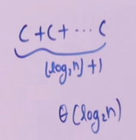

Slide 15
T(n)=2T(n/2)+c T(1)=c

Slide 16
